Slide 1

UTWATCH
AI-Based Disease Outbreak Detection Program
Team Members
BHAVIK G NAIR ( LEAD)
ABINAND T V
MOHAMMED RISHAL T
Team ID: H26HLT08
COLLEGE NAME:
COCHIN UNIVERSITY COLLEGE OF ENGINEERING KUTTANAD

Slide 2
Problem Statement
In India most of the people identify outbreaks only after a significant rise in reported cases, leaving people unaware of emerging health risks in specific regions. This delay increases the likelihood of exposure to the diseases
Objectives of the Proposed Solution
Detect unusual increases in disease cases using AI and historical health data.
Predict potential disease outbreak hotspots before they become severe.
Provide early alerts for affected regions to help people make necessary precuations before travelling there or interacting with a person there

Slide 3
EXISTING SOLUTION
The Integrated Disease Surveillance Programme (IDSP) collects disease data through a hierarchical reporting system, where information passes from local health centers to district, state, and national authorities. This process can delay outbreak reporting, causing the public to receive information only after the disease has already spread.
How OutWatch Improves It:
Uses AI to detect unusual increases in disease cases early.
Predicts potential outbreak hotspots before they become severe.
Provides easy-to-understand regional alerts for the public.
TECHNICAL GAPS
False alerts in low-case regions due to unstable statistical calculations.
Overlapping baseline windows reduce the ability to detect real outbreaks.
Single alert threshold cannot balance early detection and false alarms.
Parameter tuning bias can lead to unrealistic evaluation results.
Different districts show different disease patterns, making one-size-fits-all settings less effective.

Slide 4
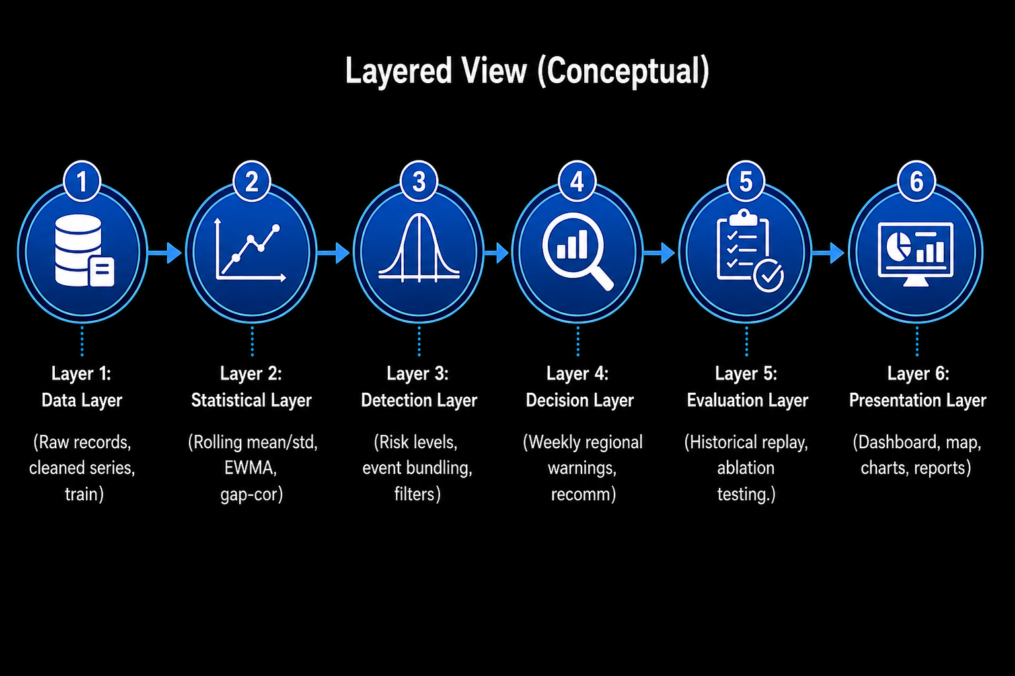
SYSTEM DESIGN

Slide 5
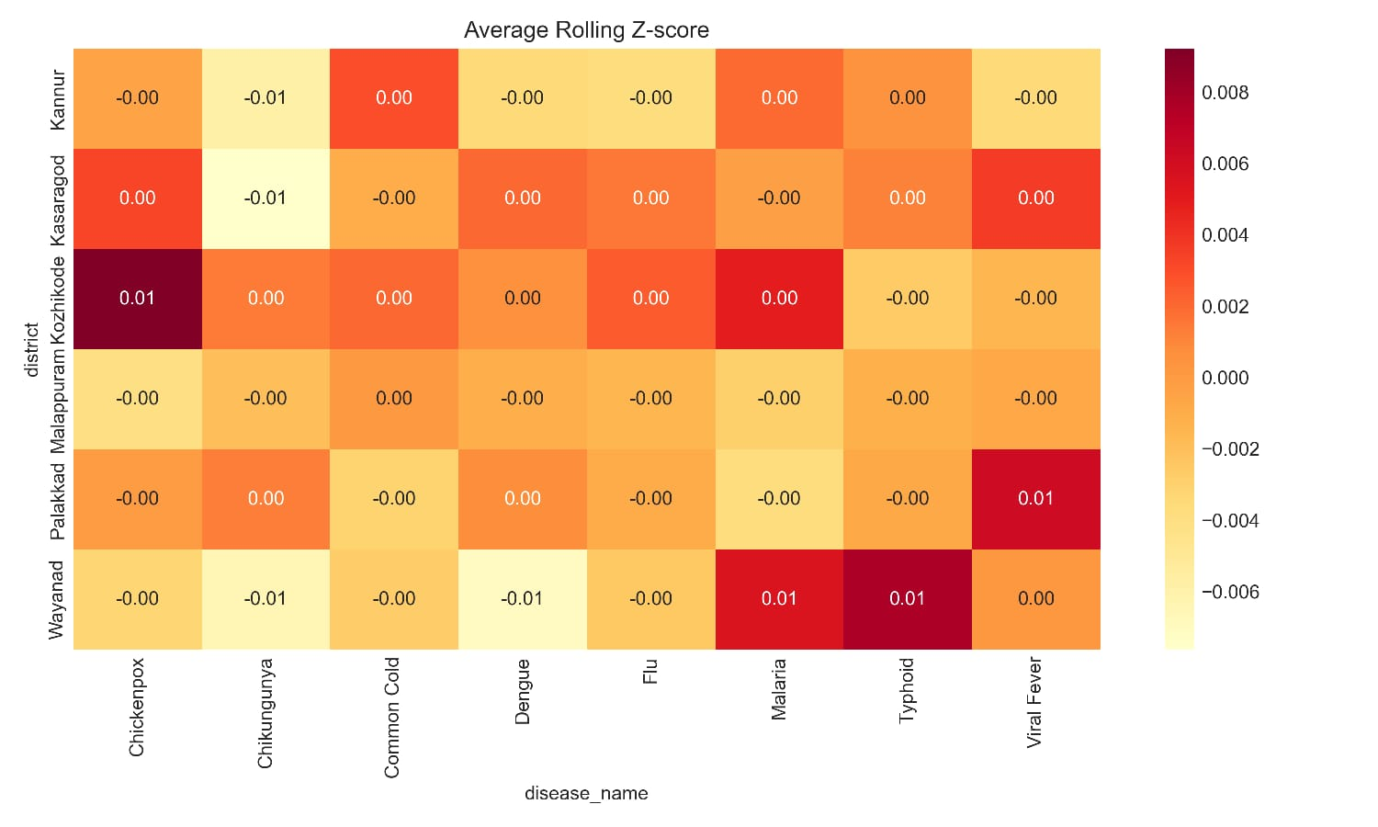
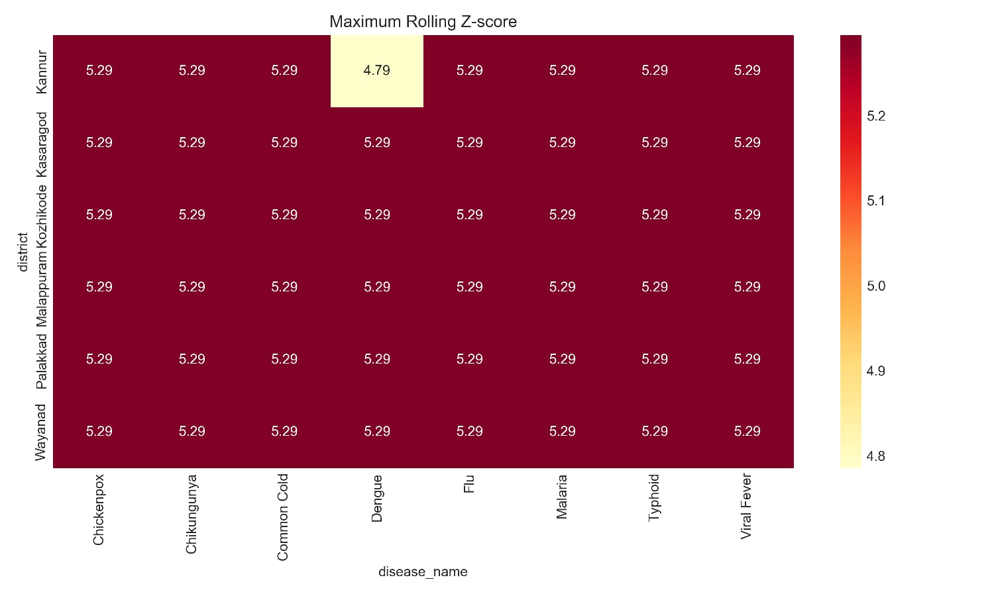
IMPLEMENTATION PROGRESS……..
Successfully implemented the supervised chess AI training pipeline.Completed PGN dataset preprocessing, board encoding, move encoding, and dataset generation.
Developed and verified the PyTorch data loader and CNN model.Implemented the training pipeline with checkpoint saving, validation, and performance tracking.
All implementation tests passed, and the training process has been successfully executed, with the model currently progressing through training and showing improving validation performance.

Slide 6
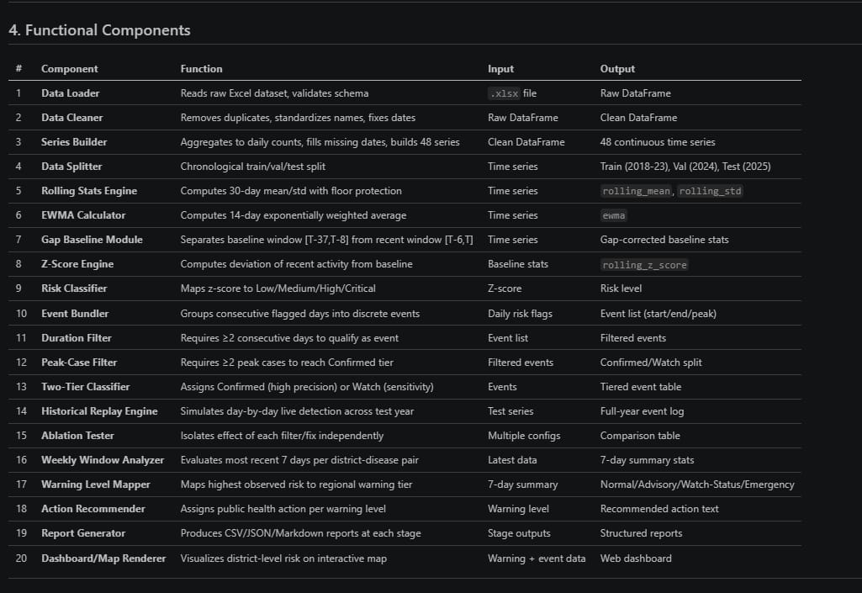
FUNCTIONS COMPLETED

Slide 7
THANK YOU

